Slide 1



Resistor Color Code Calculator
Prepared & presented by
Group 1
Hockyan TEE
Izanorshahril IBRAHIM
Xiaofen LO
Muhamadfikri ZANIL

Slide 2
Agenda
#3
Objective
#7
Demo With GUI
#4
Overview
#8-10
Codes & Pseudocode – X GUI
#5
Methodology
#11-13
Codes & Pseudocode – √ GUI
#6
Demo Without GUI
#14
Q & A

Slide 3
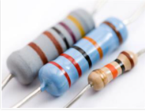
Objective
Design & develop a Resistor Color Code Calculator. By using this tool, user can easily know the resistance value of a resistor without using Ohmmeter to measure the resistance.
6 bands resistor
5 bands resistor
4 bands resistor

Slide 4
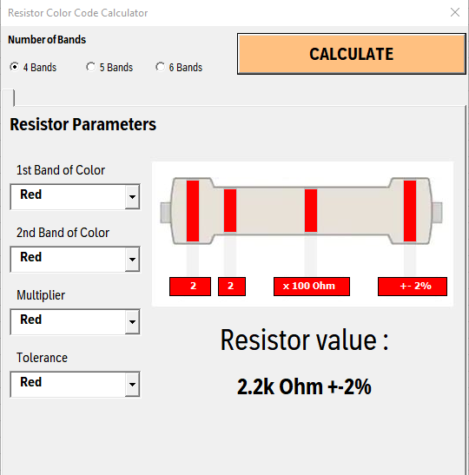
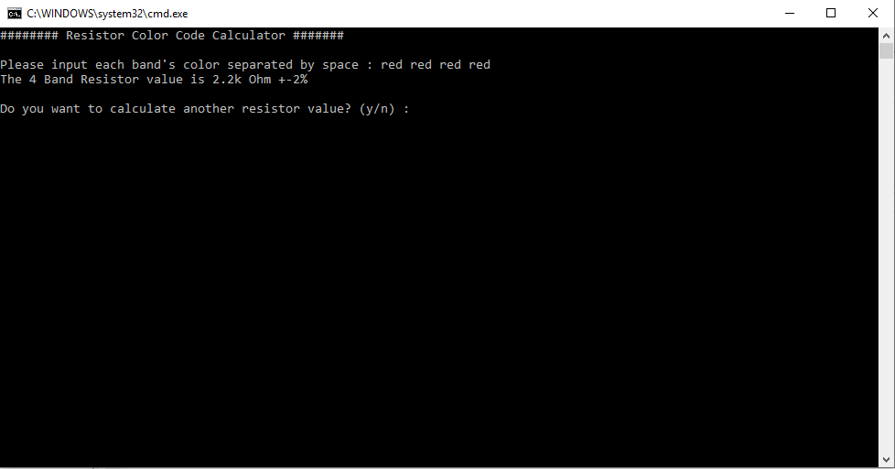
Overview
In this project, we will show two approaches.
Calculator with GUI
Calculator without GUI

Slide 5
Methodology
Calculator with GUI
Calculator without GUI
Looping between VBA / BATCH / PYTHON.
PYTHON
CALCULATOR
VBA
GUI DEVELOPMENT
PYTHON
CALCULATOR
BATCH
BATCH
Looping within Python, user can input y or n to run or terminate the program.
BATCH automates the execution of this calculator.
PYTHON is where the calculation done.
BATCH automates the execution of this calculator.
PYTHON is where the calculation done.
GUI works to ensure the tool is user friendly.
User only needs to select the right color through GUI.
User must be able to input color code in English wording.

Slide 6

Demo

Slide 7


Slide 8
Codes & Pseudocode – X GUI - BATCH
@echo off
cd C:\Users\teeho\Desktop\py\Assignment\Done_Band4_Band5_Band6\Without_GUI
set root=C:\ProgramData\Miniconda3
call %root%\Scripts\activate.bat %root%
call activate learn-python
test&cls
call python Resistor.py
pause
Turned off display of executed command lines
Direct to file location
Create & assign a variable called “root”
Run Miniconda
Activate Python environment
Clear screen in CMD
Run Python script Resistor.py
Only works when errors occur else it won’t pause

Slide 9
Codes & Pseudocode – X GUI – Main flow
run=1
while(run==1):
print ("######## Resistor Color Code Calculator #######")
userInput = checkInput(getInput())
if(len(userInput) == 4):
x1 = int(num_code[userInput[0]])
x2 = int(num_code[userInput[1]])
x3 = float(multiplier[userInput[2]])
x4 = tolerance[userInput[3]]
Rvalue = ((x1*10)+x2)*x3
ans = simplify_ans(Rvalue)
print("The 4 Band Resistor value is {} {} \n".format(ans,x4))
elif(len(userInput) == 5):
x1 = int(num_code[userInput[0]])
x2 = int(num_code[userInput[1]])
x3 = int(num_code[userInput[2]])
x4 = float(multiplier[userInput[3]])
x5 = tolerance[userInput[4]]
Rvalue = ((x1*100)+(x2*10)+x3)*x4
ans = simplify_ans(Rvalue)
print("The 5 Band Resistor value is {} {} \n".format(ans,x5))
elif(len(userInput) == 6):
x1 = int(num_code[userInput[0]])
x2 = int(num_code[userInput[1]])
x3 = int(num_code[userInput[2]])
x4 = float(multiplier[userInput[3]])
x5 = tolerance[userInput[4]]
x6 = ppm[userInput[5]]
Rvalue = ((x1*100)+(x2*10)+x3)*x4
ans = simplify_ans(Rvalue)
print("The 6 Band Resistor value is {} {} {} \n".format(ans,x5,x6))
run=0
while(1):
recalc = input("Do you want to calculate another resistor value? (y/n) : ")
if(recalc == 'y'):
run=1
print("\n")
break
if(recalc == 'n'):
print("\nByeBye.Thank you.")
break
else:
print("\nInvalid Input\n")
Convert color code into values and store in variables such as x1, x2, x3, x4.
Calculation
Adding prefix to result to have better visibility, such as M Ohm.
This is 5 Band routine which is similar routine as 4 bands but more variables.
This is 6 Band routine which is similar routine as 4 bands but more variables.
Ask user whether to continue or
terminate the program.

Slide 10
Codes & Pseudocode – X GUI – Techniques Used
Processing
input
def getInput():
userInput = [x for x in input("\nPlease input each band's color separated by space : ").split(" ")] #takes all input then split by each space
userInput = [x.lower() for x in userInput] #to make all lower case so it''ll be easy to compare later
#print(userInput) # check userInput
return userInput
def checkInput(userInput):
if(len(userInput) < 4):
print("\nLess than 4 inputs, let's try again :)")
userInput = checkInput(getInput())
elif(len(userInput) > 6):
# print("\nMore than 6 inputs...calculate the 1st six only :) ")
# userInput = userInput[:6]
print("\nMore than 6 inputs, please check again :)")
userInput = checkInput(getInput())
elif(len(userInput) == 4):
if userInput[0] not in num_code.keys():
print("\nInvalid 1st color input! Please enter the colors in the list below only. Thanks")
print(num_code.keys())
userInput = checkInput(getInput())
elif userInput[1] not in num_code.keys():
print("\nInvalid 2nd color input! Please enter the colors in the list below only. Thanks")
print(num_code.keys())
userInput = checkInput(getInput())
elif userInput[2] not in multiplier.keys():
print("\nInvalid 3rd color input! Please enter the colors in the list below only. Thanks")
print(multiplier.keys())
userInput = checkInput(getInput())
elif userInput[3] not in tolerance.keys():
print("\nInvalid 4th color input! Please enter the colors in the list below only. Thanks")
print(tolerance.keys())
userInput = checkInput(getInput())
elif(len(userInput) == 5) or (len(userInput) == 6):
if userInput[0] not in num_code.keys():
print("\nInvalid 1st color input! Please enter the colors in the list below only. Thanks")
print(num_code.keys())
userInput = checkInput(getInput())
elif userInput[1] not in num_code.keys():
print("\nInvalid 2nd color input! Please enter the colors in the list below only. Thanks")
print(num_code.keys())
userInput = checkInput(getInput())
elif userInput[2] not in num_code.keys():
print("\nInvalid 3rd color input! Please enter the colors in the list below only. Thanks")
print(num_code.keys())
userInput = checkInput(getInput())
elif userInput[3] not in multiplier.keys():
print("\nInvalid 4th color input! Please enter the colors in the list below only. Thanks")
print(multiplier.keys())
userInput = checkInput(getInput())
elif userInput[4] not in tolerance.keys():
print("\nInvalid 5th color input! Please enter the colors in the list below only. Thanks")
print(tolerance.keys())
userInput = checkInput(getInput())
if (len(userInput) == 6):
if userInput[5] not in ppm.keys():
print("\nInvalid 6th color input! Please enter the colors in the list below only. Thanks")
print(ppm.keys())
userInput = checkInput(getInput())
return userInput
def simplify_ans (Rvalue):
if Rvalue >= 1000000000:
ans = str(Rvalue/1000000000) + "G Ohm"
elif 1000000 <= Rvalue <=1000000000:
ans = str(Rvalue/1000000000) + "M Ohm"
elif 1000 <= Rvalue <=1000000:
ans = str(Rvalue/1000) + "k Ohm"
elif 0 <= Rvalue <=1000:
ans = str(Rvalue/1000) + "Ohm"
return ans
num_code = {
'black': '0',
'brown': '1',
'red': '2',
'orange':'3',
'yellow':'4',
'green':'5',
'blue':'6',
'violet':'7',
'grey':'8',
'white':'9'
}
multiplier = {
'black': '1',
'brown': '10',
'red': '100',
'orange':'1000',
'yellow':'10000',
'green':'100000',
'blue':'1000000',
'violet':'10000000',
'grey':'100000000',
'white':'1000000000',
'gold': '0.1',
'silver': '0.01'
}
tolerance = {
'brown' : '+-1%',
'red' : '+-2%',
'green' : '+-0.5%',
'blue' : '+-0.25%',
'violet' : '+-0.1%',
'grey' : '+-0.05%',
'gold' : '+-5%',
'silver' : '+-10%'
}
ppm = {
'brown' : '100ppm',
'red' : '50ppm',
'orange' : '15ppm',
'yellow' : '25ppm',
'blue' : '10ppm',
'violet' : '5ppm'
Function which simplifies input with added prefix.
Declarations of dictionaries
Error handlers if received wrong inputs.

Slide 11
Codes & Pseudocode – √ GUI - BATCH
Function CreateBatchFile(filename As String)
Dim fso
Dim file
Set fso = CreateObject("Scripting.FileSystemObject")
Set file = fso.CreateTextFile(ThisWorkbook.Path & "\" & filename, True)
file.WriteLine "@echo off"
file.WriteLine "cd " & ThisWorkbook.Path
file.WriteLine "set root=C:\ProgramData\Miniconda3"
file.WriteLine "call %root%\Scripts\activate.bat %root%"
file.WriteLine "call activate learn-python"
If Me.OptionButton1.Value = True Then
file.WriteLine "call python Resistor.py " & Me.ComboBox1.Value & " " & Me.ComboBox2.Value & " " & Me.ComboBox3.Value & " " & Me.ComboBox4.Value
ElseIf Me.OptionButton2.Value = True Then
file.WriteLine "call python Resistor.py " & Me.ComboBox5.Value & " " & Me.ComboBox6.Value & " " & Me.ComboBox7.Value & " " & Me.ComboBox8.Value & " " & Me.ComboBox13.Value
ElseIf Me.OptionButton3.Value = True Then
file.WriteLine "call python Resistor.py " & Me.ComboBox9.Value & " " & Me.ComboBox10.Value & " " & Me.ComboBox11.Value & " " & Me.ComboBox12.Value & " " & Me.ComboBox14.Value & " " & Me.ComboBox15.Value
End If
file.Close
Set file = Nothing
Set fso = Nothing
Similar routine but writing in another programming language VBA.
And also added communication by giving color code information from VBA to Python script through these commands.

Slide 12
Codes & Pseudocode – √ GUI – Main flow
run=1
while(run==1):
#print ("######## Resistor Color Code Calculator #######")
userInput = checkInput(getInput())
if(len(userInput) == 4):
x1 = int(num_code[userInput[0]])
x2 = int(num_code[userInput[1]])
x3 = float(multiplier[userInput[2]])
x4 = tolerance[userInput[3]]
Rvalue = ((x1*10)+x2)*x3
ans = simplify_ans(Rvalue)
sys.stdout.write("{} {}".format(ans,x4))
elif(len(userInput) == 5):
x1 = int(num_code[userInput[0]])
x2 = int(num_code[userInput[1]])
x3 = int(num_code[userInput[2]])
x4 = float(multiplier[userInput[3]])
x5 = tolerance[userInput[4]]
Rvalue = ((x1*100)+(x2*10)+x3)*x4
ans = simplify_ans(Rvalue)
sys.stdout.write("{} {}".format(ans,x5))
elif(len(userInput) == 6):
x1 = int(num_code[userInput[0]])
x2 = int(num_code[userInput[1]])
x3 = int(num_code[userInput[2]])
x4 = float(multiplier[userInput[3]])
x5 = tolerance[userInput[4]]
x6 = ppm[userInput[5]]
Rvalue = ((x1*100)+(x2*10)+x3)*x4
ans = simplify_ans(Rvalue)
sys.stdout.write("{} {} {}".format(ans,x5,x6))
run=0
#while(1):
# recalc = input("Do you want to calculate another resistor value? (y/n) : ")
# if(recalc == 'y'):
# run=1
# print("\n")
# break
# if(recalc == 'n'):
# print("\nByeBye.Thank you.")
# break
# else:
# print("\nInvalid Input\n")
Disable headers in python as python no more visible.
Convert color code into values and store in variables such as x1, x2, x3, x4.
Calculation
Adding prefix to result to have better visibility, such as M Ohm.
This is 5 Band routine which is similar routine as 4 bands but more variables.
This is 6 Band routine which is similar routine as 4 bands but more variables.
Disable looping within Python as looping control by VBA.

Slide 13
Codes & Pseudocode – √ GUI – Techniques Used
Processing
input received from VBA
import sys
def getInput():
y = ""
if (len(sys.argv)-1) == 4 :
y = sys.argv[1] + " " + sys.argv[2] + " " + sys.argv[3] + " " + sys.argv[4]
elif (len(sys.argv)-1) == 5 :
y = sys.argv[1] + " " + sys.argv[2] + " " + sys.argv[3] + " " + sys.argv[4] + " " + sys.argv[5]
elif (len(sys.argv)-1) == 6 :
y = sys.argv[1] + " " + sys.argv[2] + " " + sys.argv[3] + " " + sys.argv[4] + " " + sys.argv[5] + " " + sys.argv[6]
userInput = [x for x in y.split(" ")] #takes all input then split by each space
userInput = [x.lower() for x in userInput] #to make all lower case so it''ll be easy to compare later
#print(userInput) # check userInput
return userInput
def checkInput(userInput):
if(len(userInput) < 4):
print("\nLess than 4 inputs, let's try again :)")
userInput = checkInput(getInput())
elif(len(userInput) > 6):
# print("\nMore than 6 inputs...calculate the 1st six only :) ")
# userInput = userInput[:6]
print("\nMore than 6 inputs, please check again :)")
userInput = checkInput(getInput())
elif(len(userInput) == 4):
if userInput[0] not in num_code.keys():
print("\nInvalid 1st color input! Please enter the colors in the list below only. Thanks")
print(num_code.keys())
userInput = checkInput(getInput())
elif userInput[1] not in num_code.keys():
print("\nInvalid 2nd color input! Please enter the colors in the list below only. Thanks")
print(num_code.keys())
userInput = checkInput(getInput())
elif userInput[2] not in multiplier.keys():
print("\nInvalid 3rd color input! Please enter the colors in the list below only. Thanks")
print(multiplier.keys())
userInput = checkInput(getInput())
elif userInput[3] not in tolerance.keys():
print("\nInvalid 4th color input! Please enter the colors in the list below only. Thanks")
print(tolerance.keys())
userInput = checkInput(getInput())
elif(len(userInput) == 5) or (len(userInput) == 6):
if userInput[0] not in num_code.keys():
print("\nInvalid 1st color input! Please enter the colors in the list below only. Thanks")
print(num_code.keys())
userInput = checkInput(getInput())
elif userInput[1] not in num_code.keys():
print("\nInvalid 2nd color input! Please enter the colors in the list below only. Thanks")
print(num_code.keys())
userInput = checkInput(getInput())
elif userInput[2] not in num_code.keys():
print("\nInvalid 3rd color input! Please enter the colors in the list below only. Thanks")
print(num_code.keys())
userInput = checkInput(getInput())
elif userInput[3] not in multiplier.keys():
print("\nInvalid 4th color input! Please enter the colors in the list below only. Thanks")
print(multiplier.keys())
userInput = checkInput(getInput())
elif userInput[4] not in tolerance.keys():
print("\nInvalid 5th color input! Please enter the colors in the list below only. Thanks")
print(tolerance.keys())
userInput = checkInput(getInput())
if (len(userInput) == 6):
if userInput[5] not in ppm.keys():
print("\nInvalid 6th color input! Please enter the colors in the list below only. Thanks")
print(ppm.keys())
userInput = checkInput(getInput())
return userInput
def simplify_ans (Rvalue):
if Rvalue >= 1000000000:
ans = str(Rvalue/1000000000) + "G Ohm"
elif 1000000 <= Rvalue <=1000000000:
ans = str(Rvalue/1000000000) + "M Ohm"
elif 1000 <= Rvalue <=1000000:
ans = str(Rvalue/1000) + "k Ohm"
elif 0 <= Rvalue <=1000:
ans = str(Rvalue/1000) + "Ohm"
return ans
num_code = {
'black': '0',
'brown': '1',
'red': '2',
'orange':'3',
'yellow':'4',
'green':'5',
'blue':'6',
'violet':'7',
'grey':'8',
'white':'9'
}
multiplier = {
'black': '1',
'brown': '10',
'red': '100',
'orange':'1000',
'yellow':'10000',
'green':'100000',
'blue':'1000000',
'violet':'10000000',
'grey':'100000000',
'white':'1000000000',
'gold': '0.1',
'silver': '0.01'
}
tolerance = {
'brown' : '+-1%',
'red' : '+-2%',
'green' : '+-0.5%',
'blue' : '+-0.25%',
'violet' : '+-0.1%',
'grey' : '+-0.05%',
'gold' : '+-5%',
'silver' : '+-10%'
}
ppm = {
'brown' : '100ppm',
'red' : '50ppm',
'orange' : '15ppm',
'yellow' : '25ppm',
'blue' : '10ppm',
'violet' : '5ppm'
Function which simplifies input with added prefix.
Declarations of dictionaries
No trigger anymore as error proof guaranteed
by GUI.

Slide 14
Q & A

